Slide 1

Data Dashboard
Notes:
Vinc

Slide 2
AGENDA
Team Introduction
Project Scope
Data
Our Map
Future Plans
Notes:
Vinc

Slide 3
MEET OUR TEAM
Vincent Chung: Project Manager and Software Developer
Selin Erdogan: Communications Lead and Database Developer
Jonathan Evans: Software Developer
Manuel Orallo: Data Engineer
Notes:
Vinc

Slide 4
PROJECT SCOPE
In our first meeting, we discussed some current issues in the Langley Park area that we could look at.
These included:
Legal food vending areas
Lack of public trash cans
Purple line effect on the area and housing market
Improve green spaces
Notes:
Selin

Slide 5
PROJECT SCOPE CONT.
However, we found that there was not enough data to carry out those projects.
After discussion with the group and you guys, we decided to land on an interactive map consisting of key locations in the Langley Park community.
During our second meeting, we confirmed the scope and deliverables for this map.
Notes:
Selin

Slide 6
WHAT ARE WE DOING?
Residents of Langley Park need resources to help them navigate the community. Our map will aim to focus on these resources.
Education
Recreation
Social/legal services
Religious
Health
Youth services
Transit
We are actively collaborating with the Langley Park Website Assessment team to integrate the map into their website
Notes:
Selin

Slide 7
DATA
We were able to build off an existing database from the previous semester’s group that already included some community resources in the Langley Park area.
However, in order to optimize this data for our map we had to make some additions and do some cleaning.
We Added: Locations, Hours of operation, Latitude/longitude coordinates, Website links, Categories for filtering
Notes:
Man

Slide 8
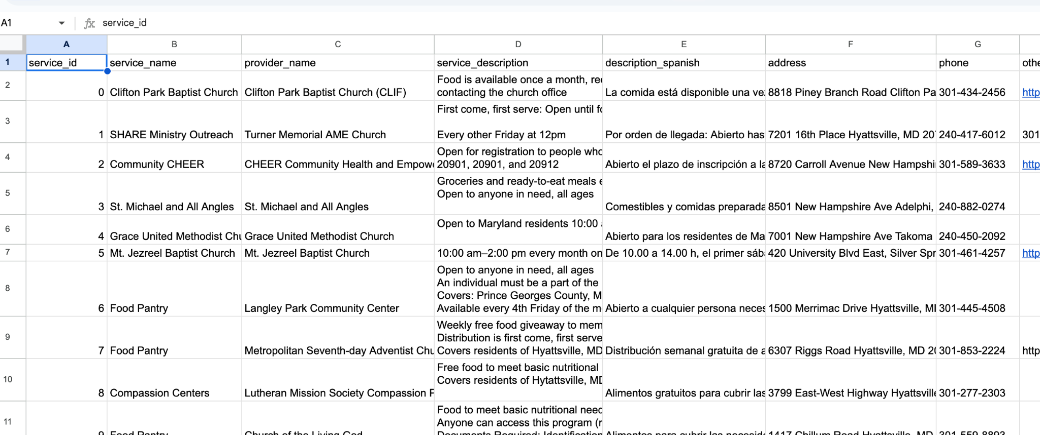
PREVIOUS DATABASE

Slide 9
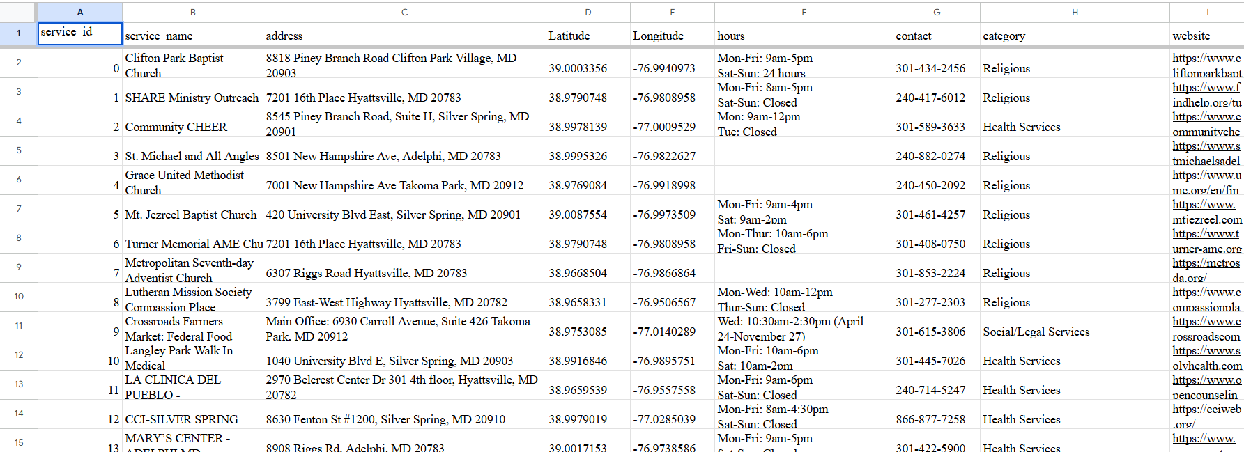
OUR UPDATED DATABASE
Notes:
Man

Slide 10
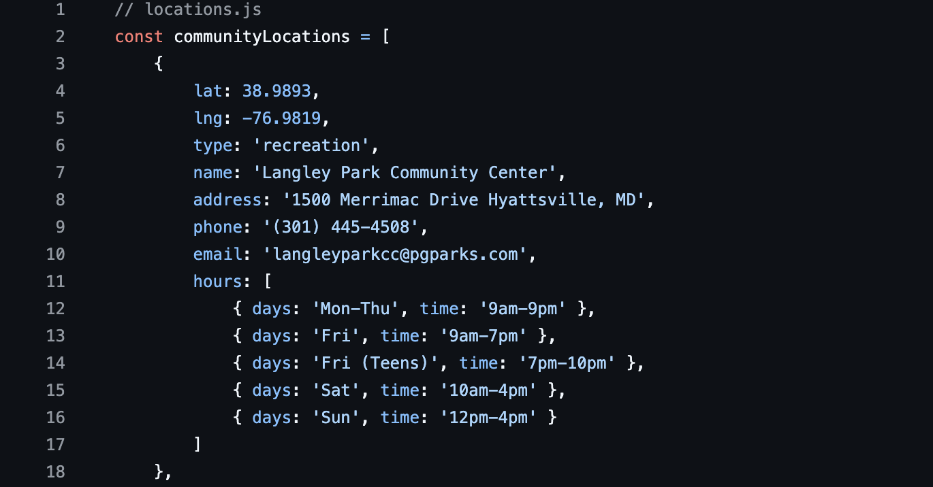
FINAL DATABASE
https://github.com/vincentchung2002/langley-park-civic-dashboard/blob/main/locations.js
Notes:
Man

Slide 11

MAPPING SOFTWARE
In order to allow easy integration into the Langley Park Civic Association website we decided to use Leaflet.js.
Leaflet is an open-source JavaScript library used to make interactive maps.
It works efficiently across all major desktop and mobile platforms, can be extended with lots of plugins, and has a easy to use and well-documented API.
Notes:
vincent

Slide 12
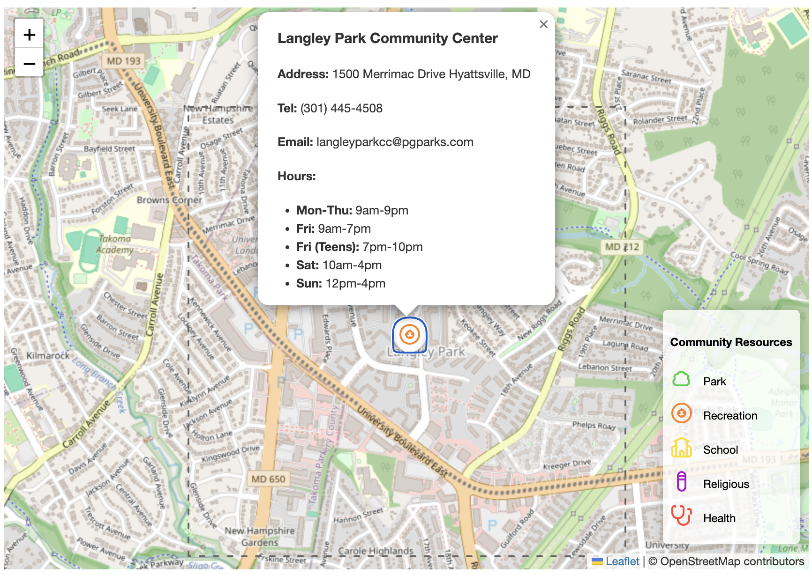
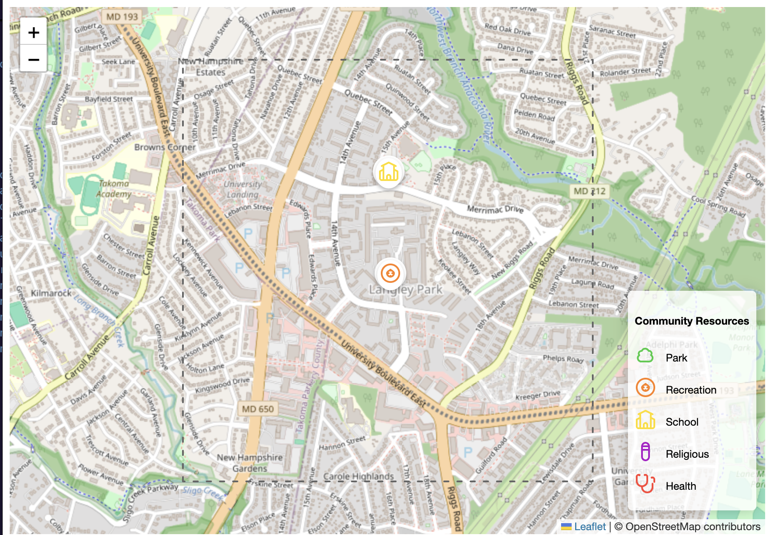
FIRST TEST
This iteration of the map consisted of some test points to see if the labeling worked properly. We also wanted to test the popup content that would appear when a location on the map was clicked.
Notes:
vinc

Slide 13
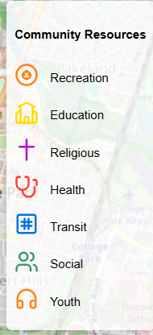
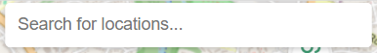
ADDING MORE FEATURES
The goal of the interactive map is to have an accessible and easy-to-use user interface. Users will be able to search specific locations or by filter by category.
Notes:
vinc

Slide 14
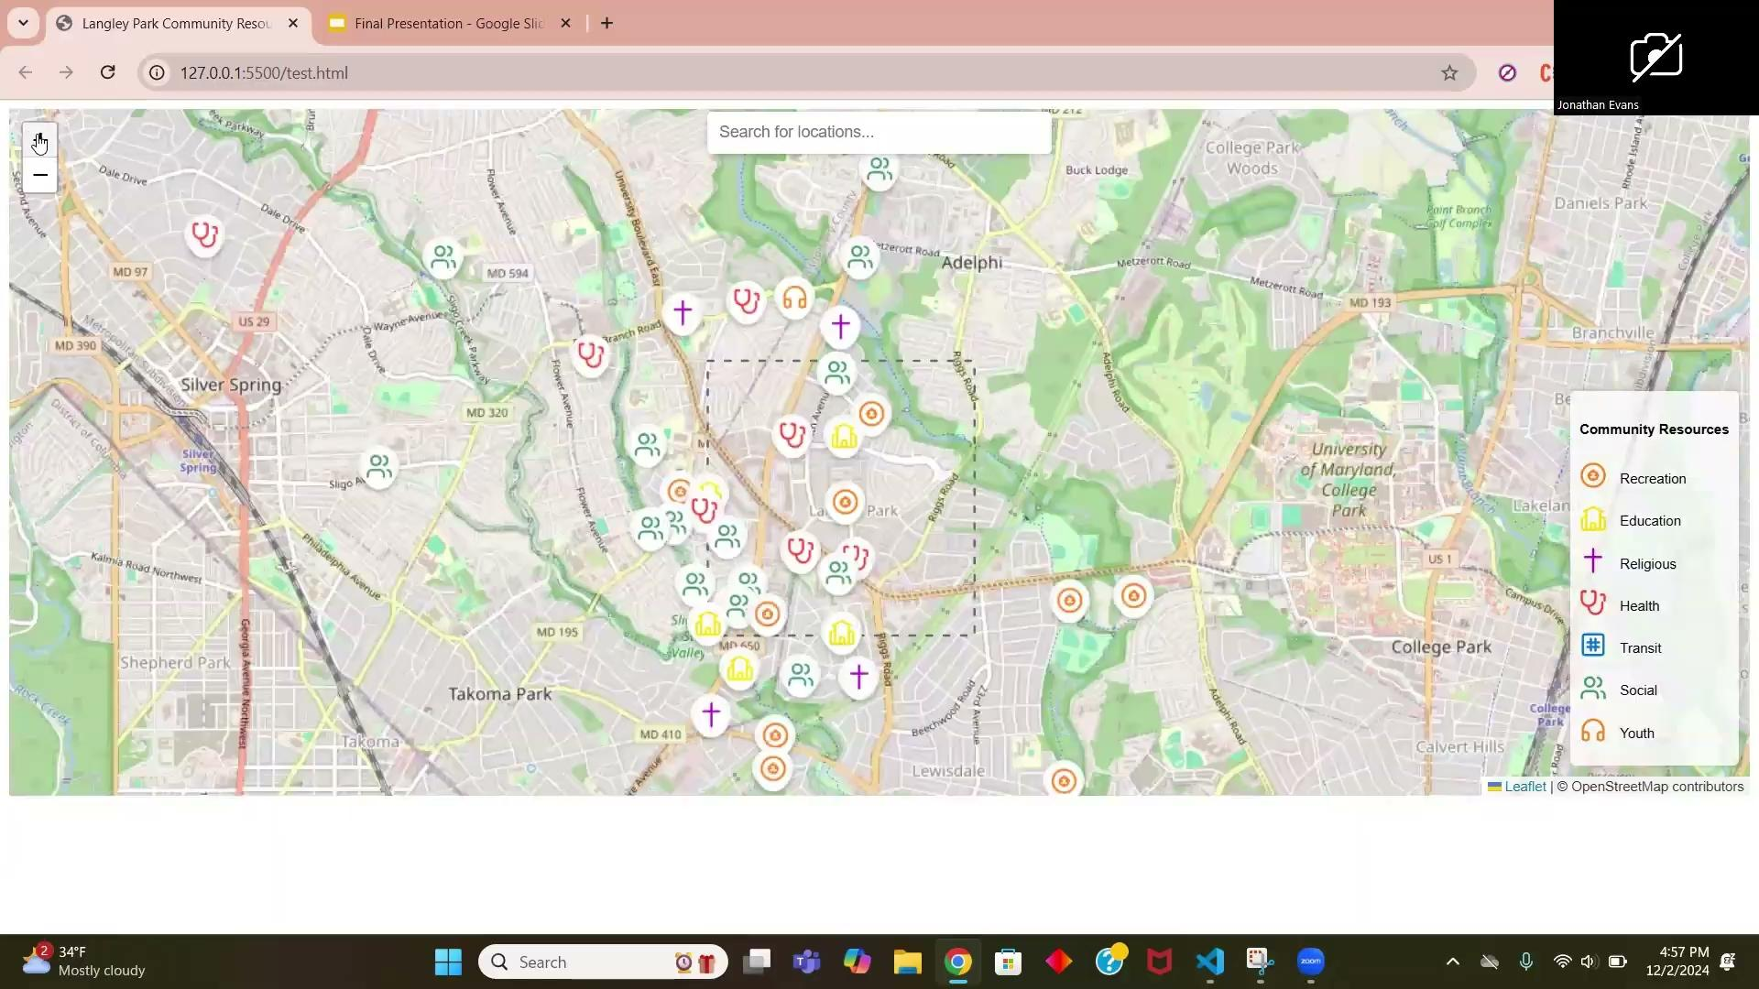
DEMONSTRATION OF MAP
https://vincentchung2002.github.io/langley-park-civic-dashboard/
https://github.com/vincentchung2002/langley-park-civic-dashboard
Notes:
vinc

Slide 15
User Guide
In order to allow you guys to update the map without our help we developed a comprehensive and easy to understand guide that you can use.
https://github.com/vincentchung2002/langley-park-civic-dashboard/blob/main/User%20Guide.pdf
Notes:
vinc

Slide 16
FINAL DELIVERABLES
Github Repository
Map code
Database
User Guide
Slide presentation

Slide 17
FUTURE PLANS
We have prepared a user manual/guide as a resource for you once this project comes to an end.
This guide will include tutorials on how to update the map with new locations and how they can add temporary event locations as well.

Slide 18
SUGGESTIONS FOR FUTURE
LANGLEY PARK GROUP
As we wrap up our contributions to this project we have come up with some points and suggestions that the future students you guys work with can use.
Automate moving the information from the database to the JSON file
Mapping of transit lines connecting different metro stations
Pictures added to the popup content in locations
Integration of a 3D map like Google Earth to capture more realism
Addition of green line transit points

Slide 19
THANK YOU!
ANY QUESTIONS?

